Slide 1

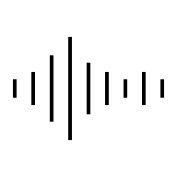
Statistical Inference Activity

Slide 2
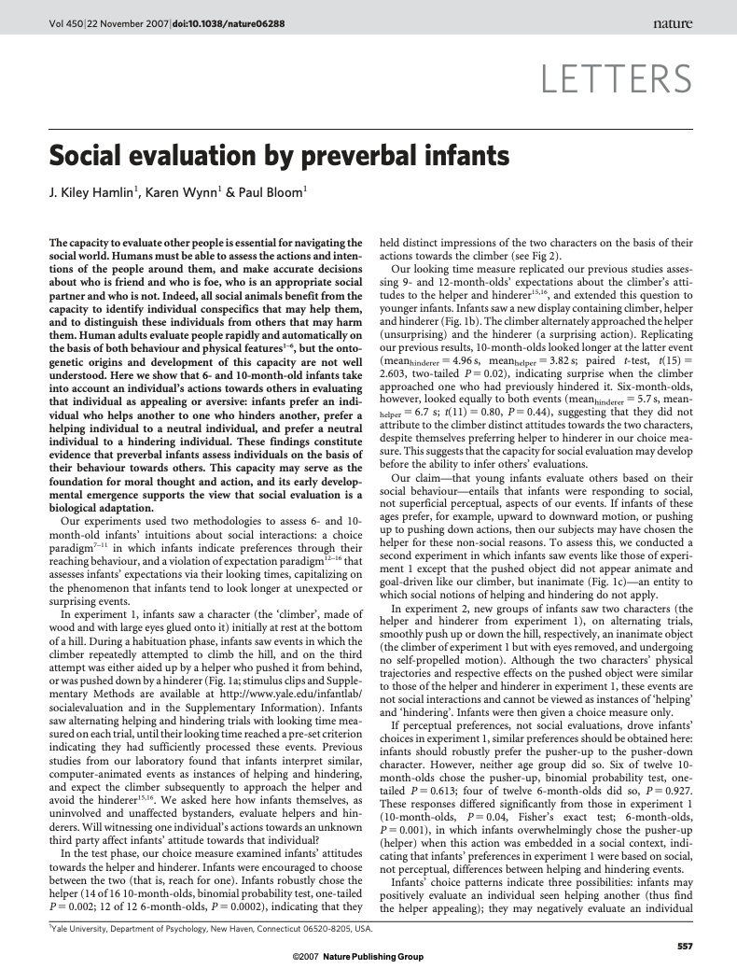
Hamlin, J. K., Wynn, K., & Bloom, P. (2007). Social evaluation by preverbal infants. Nature, 450(7169), 557-559.
as seen in Chance, B. L., & Rossman, A. J. (2006). Investigating statistical concepts, applications and methods

Slide 3
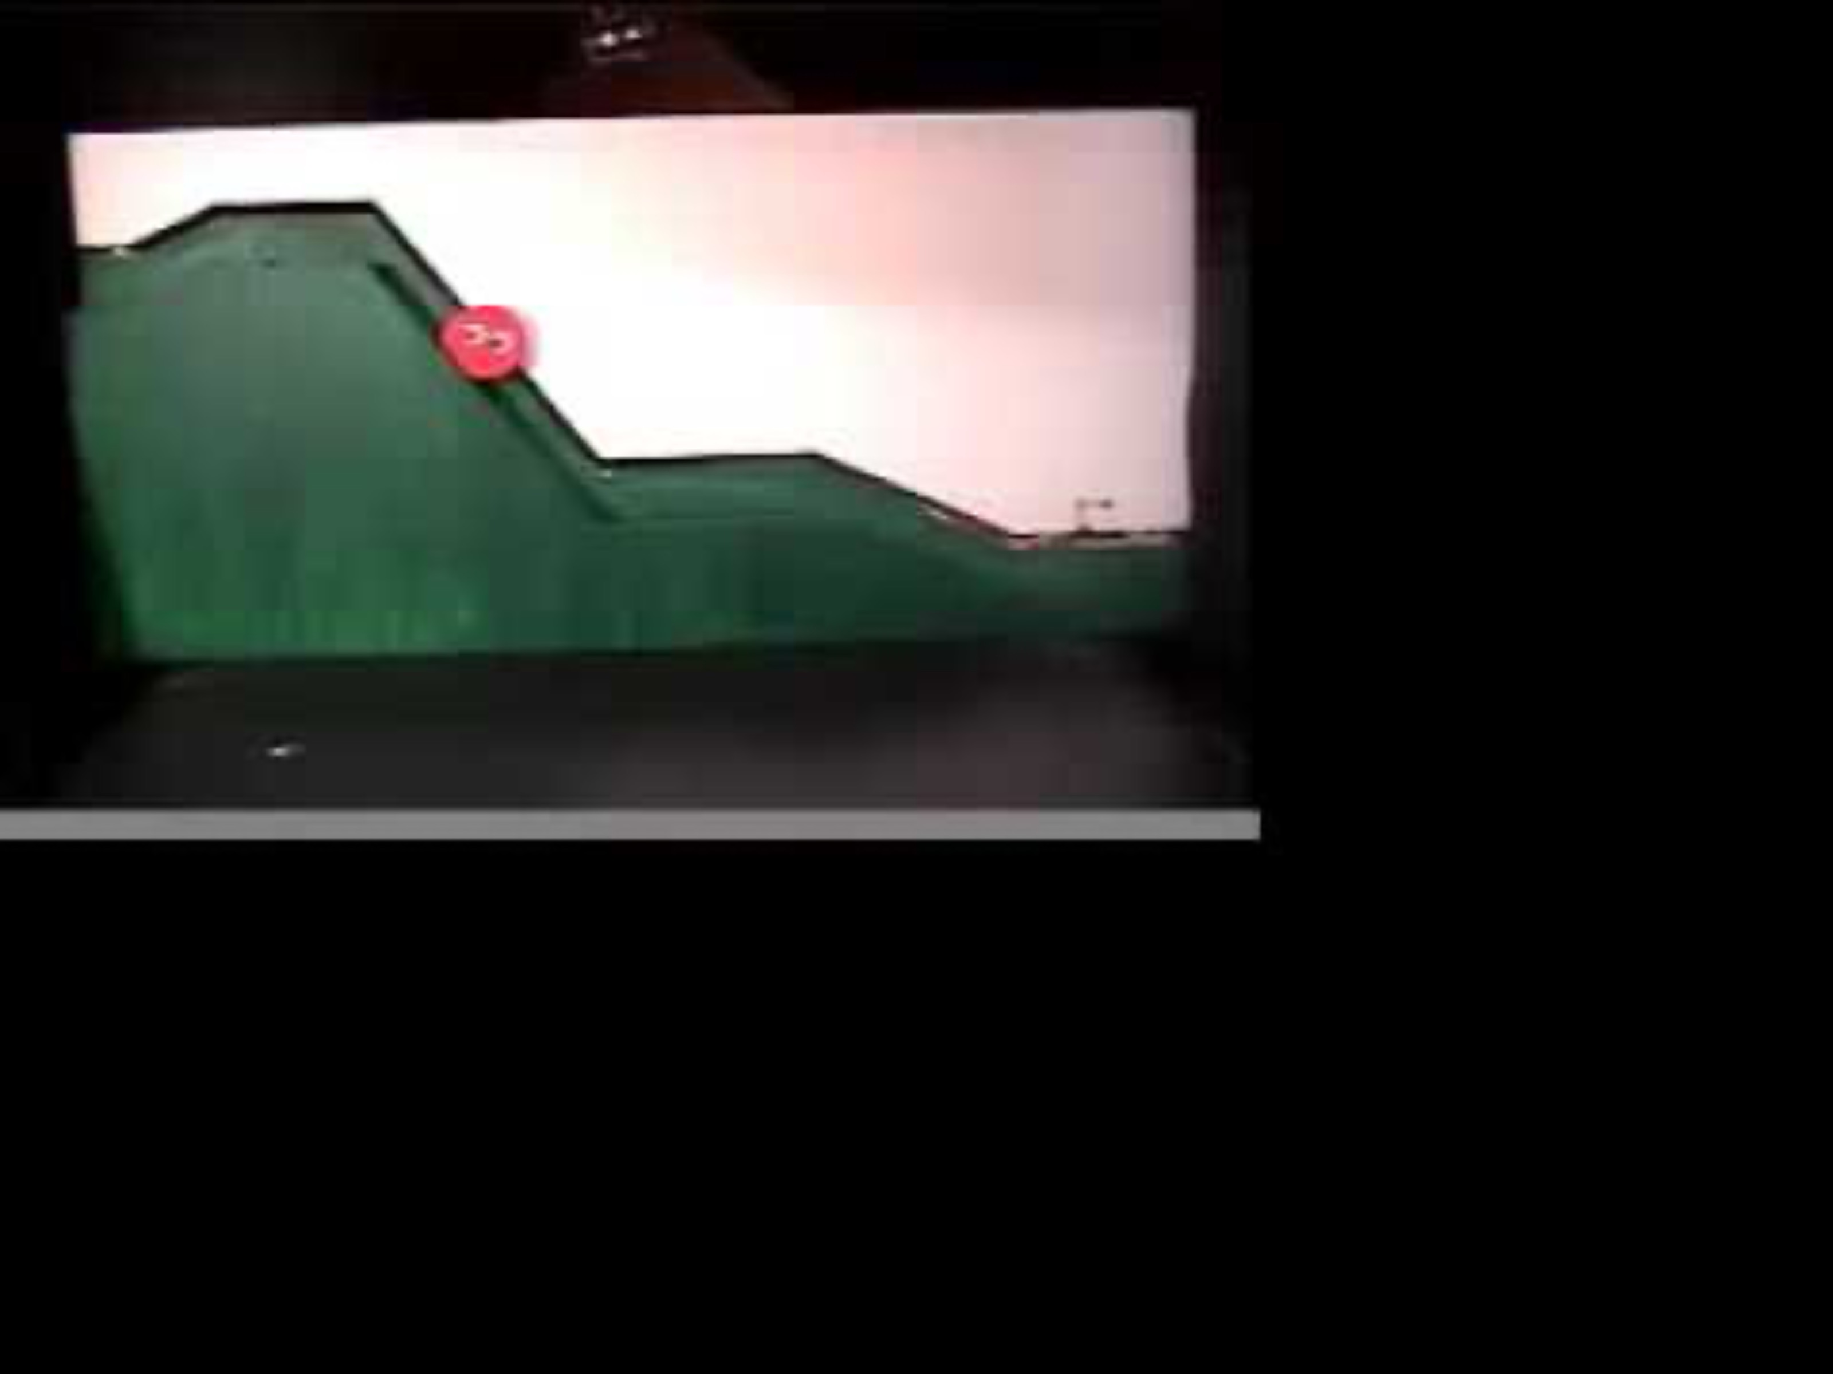
Helper shape

Slide 4
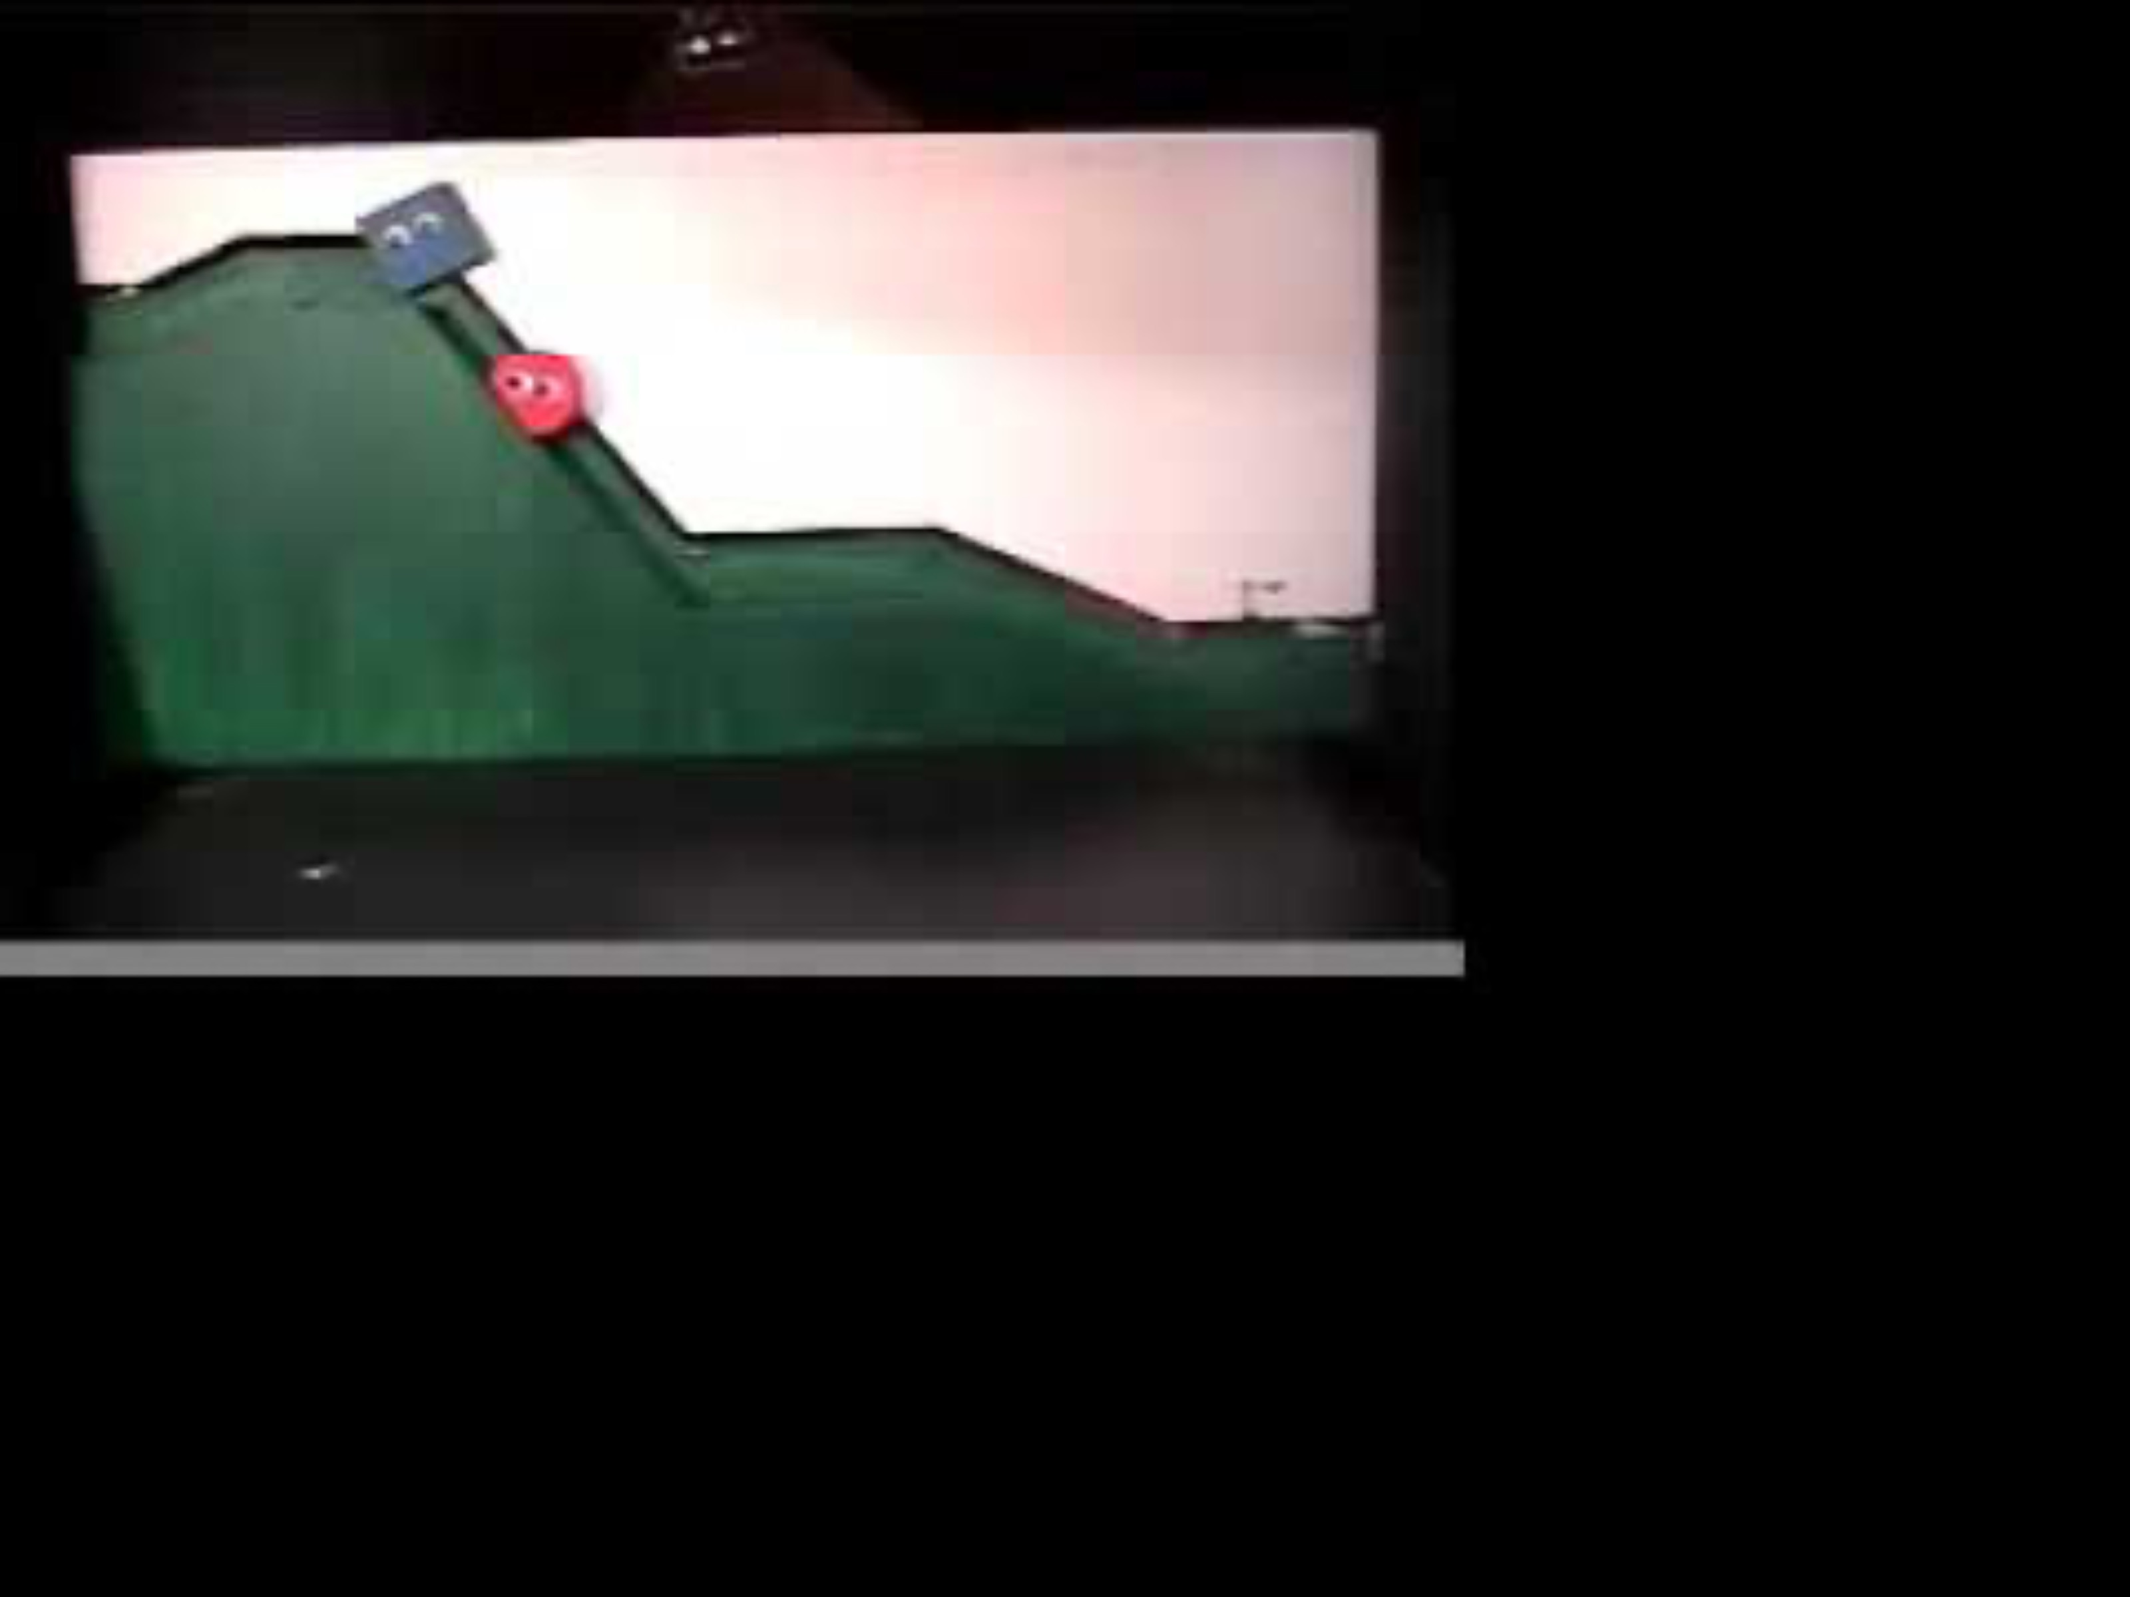
Hinderer shape

Slide 5
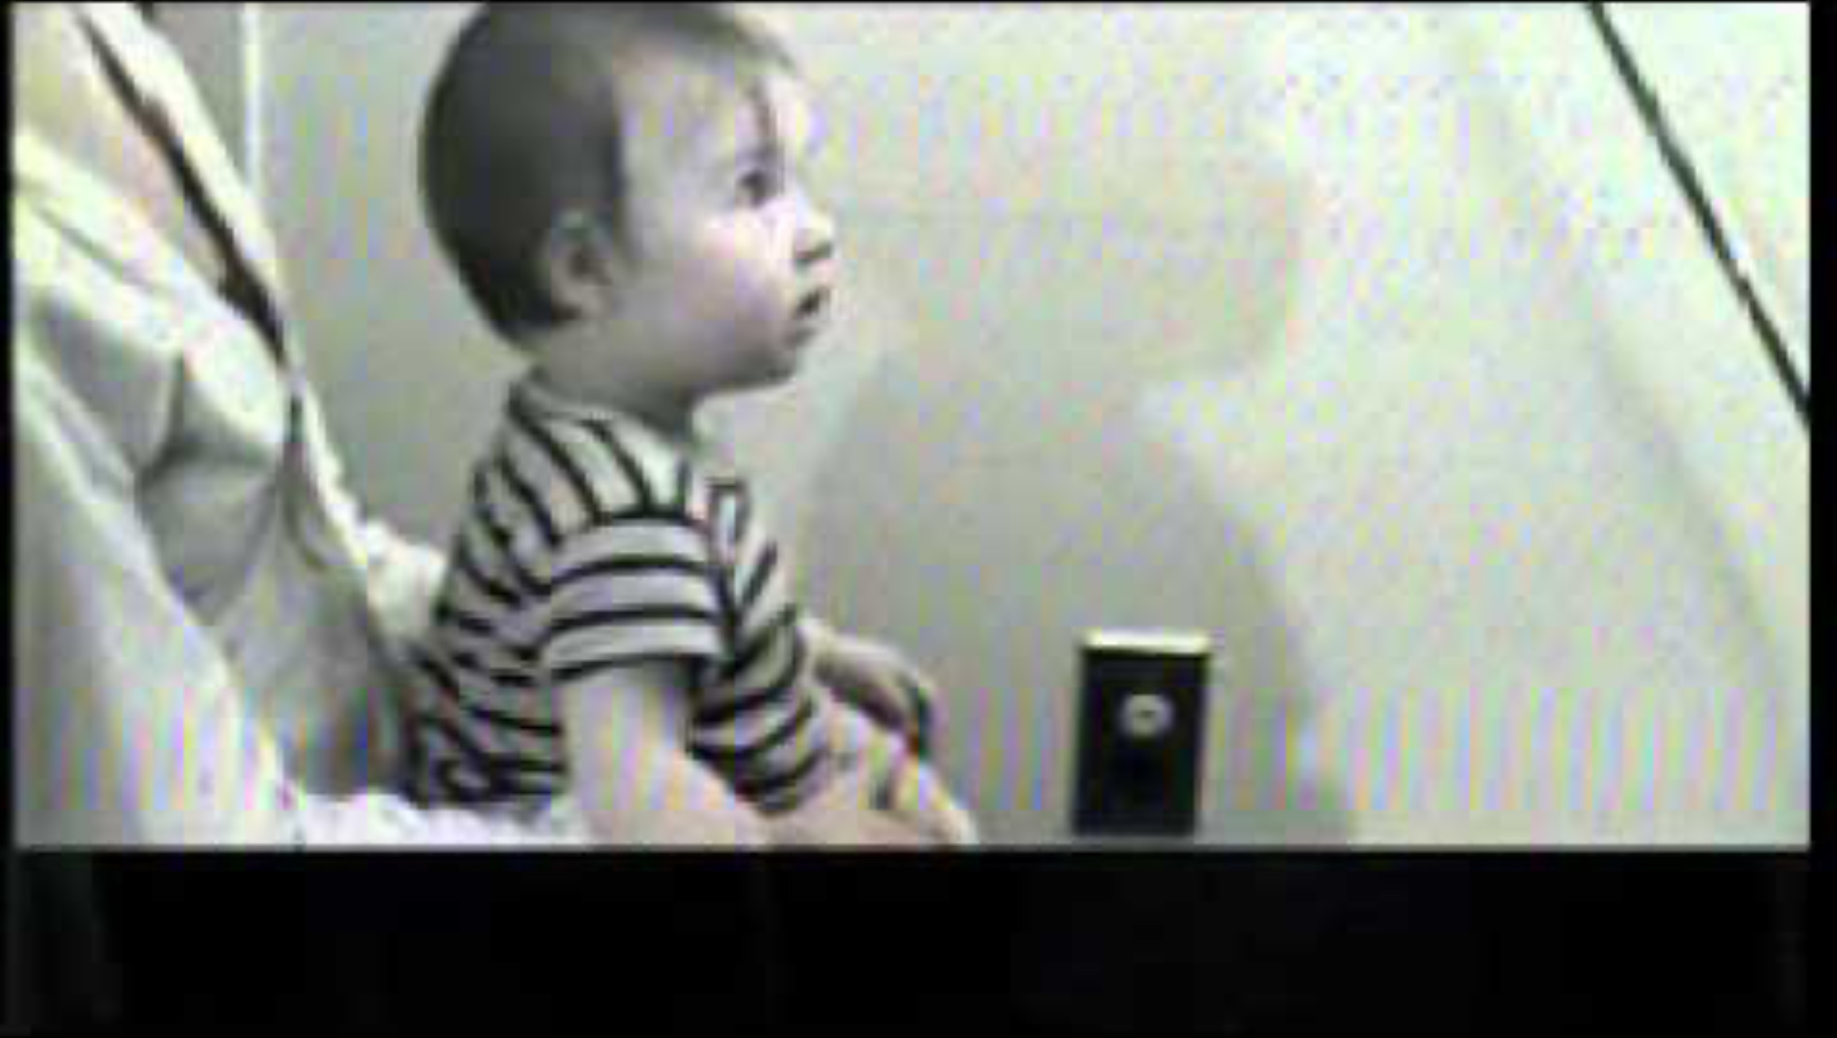
Data Collection

Slide 6
14 out of 16 infants (10-months old) have chosen the helper shape.
What are some possible explanations of this?

Slide 7
Study Design
Hypotheses
Color of the toy
Right vs. left
Shape of the toy
….
10 months old babies are socially developed
10 months old babies are making a random choice

Slide 8
Study Design
Hypotheses
Color of the toy
Right vs. left
Shape of the toy
….
10 months old babies are socially developed
10 months old babies are making a random choice
Which of these is easier to model right now?

Slide 9

Hypotheses to Test
Babies are making a random choice ($π = 0$.5)
Babies are not making a random choice ($π ≠ 0.5$)

Slide 10
Let’s assume that babies are making a random choice
Out of 16 babies, how many babies would you expect to choose the helper shape?
Could this number be 7? In other words, if babies were making random choices, would you be surprised to see 7 babies choose the helper shape?
Could this number be 11?
Could this number be 3?
Could this number be 14?

Slide 11
Let’s assume that babies are making a random choice
What is your surprise threshold? Below and above which number would you start getting surprised?
0
1
2
3
4
5
6
7
8
9
10
11
12
13
14
15
16
0
0.5
1

Slide 12
Let’s assume that babies are making a random choice
With your neighbor, flip a coin 16 times and record the number of heads that you observe.
In other words, each group is a set of researchers observing the behavior of 16 babies from Randomville.

Slide 13
https://mdogucu.shinyapps.io/proportion/
Notes:
https://mdogucu.github.io/proportion/app.R

Slide 14
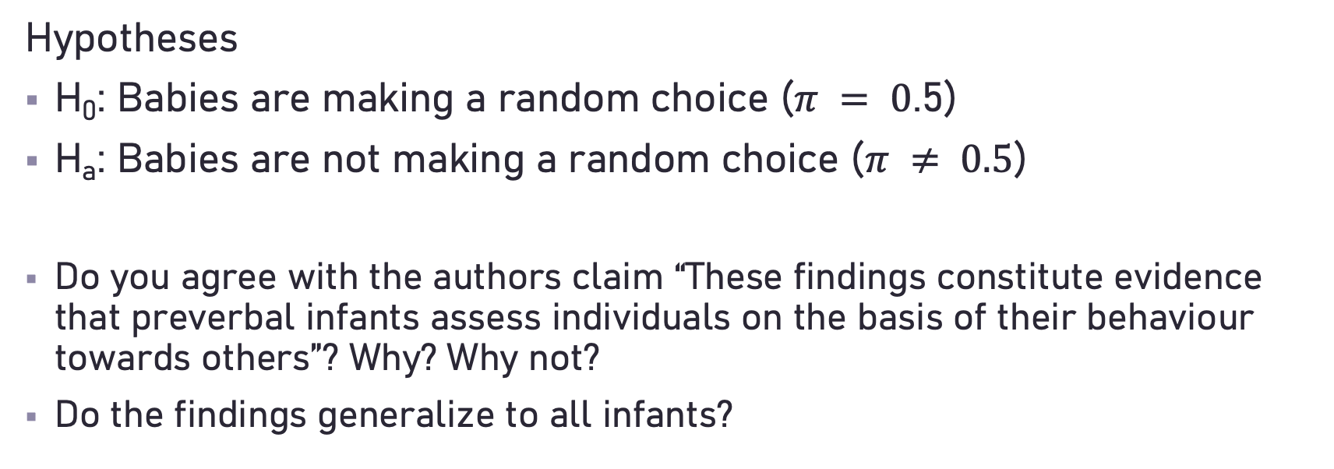
Conclusions
Hypotheses
H₀: Babies are making a random choice ($π = 0$.5)
H_{a}: Babies are not making a random choice ($π ≠ 0.5$)
Do you agree with the authors claim “These findings constitute evidence that preverbal infants assess individuals on the basis of their behaviour towards others”? Why? Why not?
Do the findings generalize to all infants?

Slide 15
Surprise (extreme) threshold
Instead of count of babies, we will often see surprise threshold set at 0.05 probability. This is a debatable topic what the surprise threshold should be.
If the sample observation is in the 0.05 highlighted region then we would be “surprised”. In other words if the sample is in the 0.05 highlighted region then we would conclude that there is a low probability of observing a surprising sample like this one or something more extreme if the randomness model were true.
If the randomness model were true there would be a low probability (less than 0.05) of observing a sample value like the one we have observed or something more extreme. So we reject the randomness model and conclude the alternative model.

Slide 16
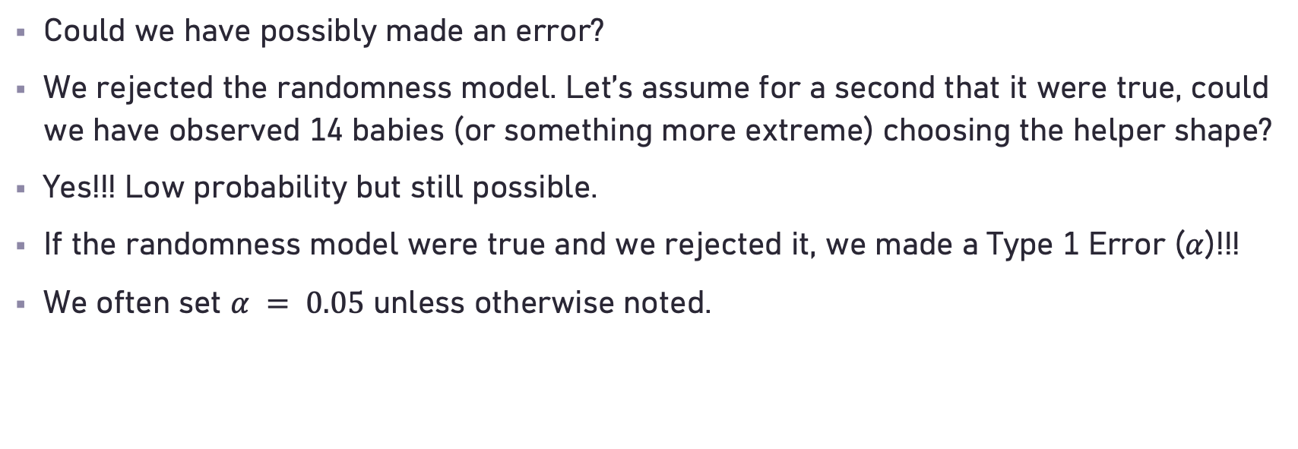
Error
Could we have possibly made an error?
We rejected the randomness model. Let’s assume for a second that it were true, could we have observed 14 babies (or something more extreme) choosing the helper shape?
Yes!!! Low probability but still possible.
If the randomness model were true and we rejected it, we made a Type 1 Error ($α$)!!!
We often set $α = 0.05$ unless otherwise noted.

